Slide 1

Environmental sound classification

Slide 2
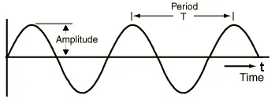
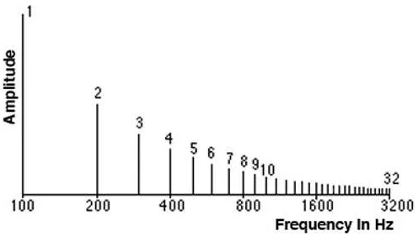
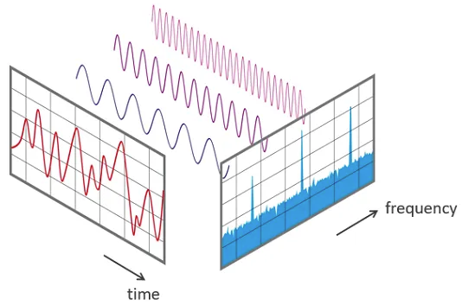
Sound signal is produced by variations in air pressure.
Spectrum is the set of frequencies that are combined to produce a signal.
Time Domain vs Frequency Domain

Slide 3
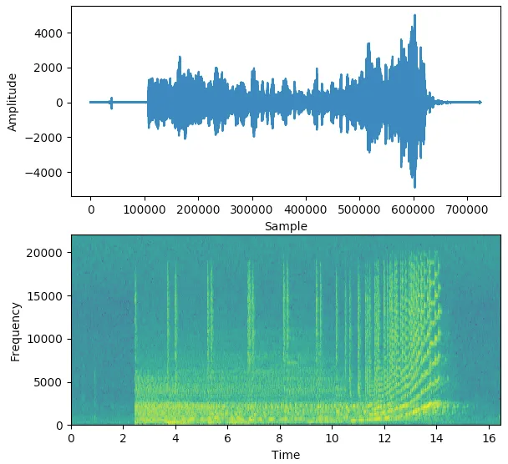
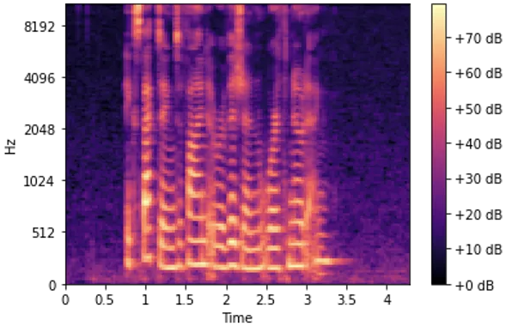
A Spectrogram of a signal plots its Spectrum over time and is like a ‘photograph’ of the signal. It plots Time on the x-axis and Frequency on the y-axis. It is as though we took the Spectrum again and again at different instances in time, and then joined them all together into a single plot.
A Mel Spectrogram makes two important changes relative to a regular Spectrogram that plots Frequency vs Time.
It uses the Mel Scale instead of Frequency on the y-axis.
It uses the Decibel Scale instead of Amplitude to indicate colors.

Slide 4
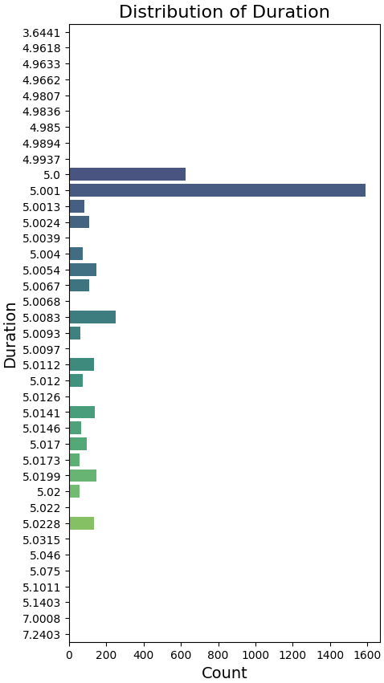
Our dataset
ESC-50: Environmental Sound Classification
Classes: 50
Total Files: 2000
Class Distribution: Equal
File time range:
Min Duration: 3.64
Max Duration: 7.24
File sampling: Most on 44100Hz
File channels: Most on one channel

Slide 5
Handling
Rechannel to 1 channel
Resampling to 44100Hz
Pad or truncate to 5sec
Generate Melgram
n_mels: 64
n_fft: 1024
hop_length: 256
Create augmented files
Add Noise
Volume Scaling
Time Stretching
Process done to all the files, so total files become 4000

Slide 6
Train/Validation
Hyperparameter Tuning: Optuna
Learning Rate: Log 1e-4 to 1e-2
Batch Size: [32, 64, 128]
Trials: Depending on experiment (usually 10+)
Epoch: Not optimized. We used 100 with early stopping (5 sequential non increasing metric)
Metric Used: Validation Accuracy (balanced classes, easier interpretation)
(originally we used log loss since we are deal probabilities, but the results was the same)
Optimization: Adam
It adapts learning rates. Tends to converge faster. More memory consumption.
Weight_decay (L2)
Used in some experiments where overfitting was suspected. Did not optimize it.

Slide 7
Total Experiments
Total configurations: 17
Total Trials: 159
Total Epochs: 2990
Total (logged) Training Hours: 130,5
System: i7, 16GB RAM, no GPU
Models Trained
SVM
Custom CNN
Pytorch Resnet18 (pretrained on ImageNet)
Pytorch Resnet18 + Custom CNN
Inputs
Melgrams (normalized and not)
Melgrams 64x860 and 860x860
MFCC

Slide 8
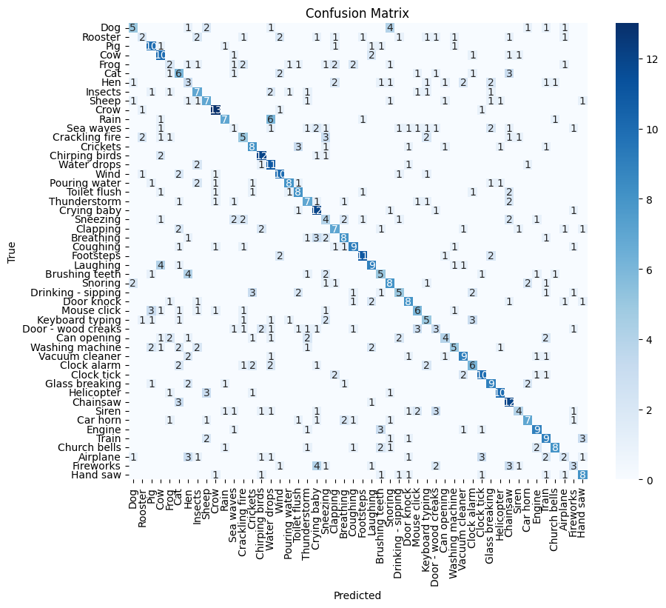
SVM
Input Size: 15 coefficients (normalized)
Kfold: 10
Val Accuracy: 46,52%
Test Accuracy: 44.63%
Best Models

Slide 9
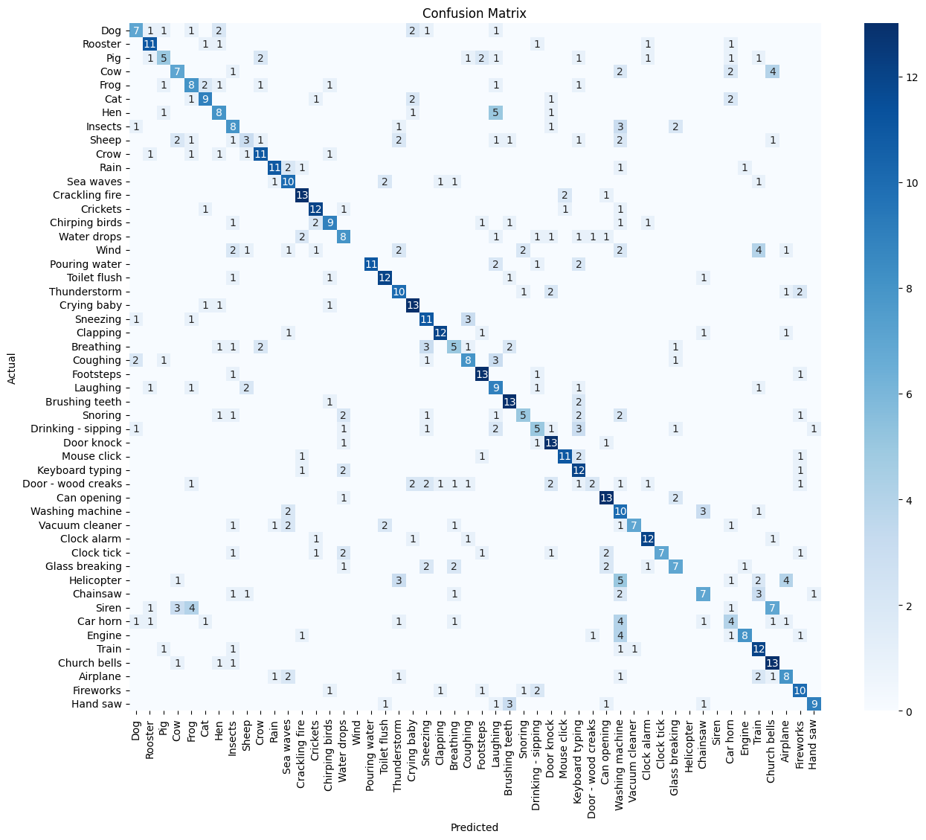
Custom CNN
Input Size: Melgram 64x860 (normalized)
Trials: 10
Weight Decay: 0.001
Val Accuracy: 53.35%
Test Accuracy: 54.00%
Best Models

Slide 10
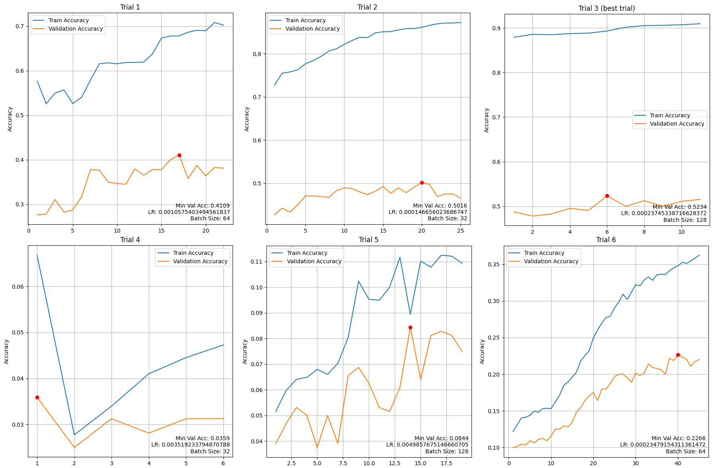
Best Models

Slide 11
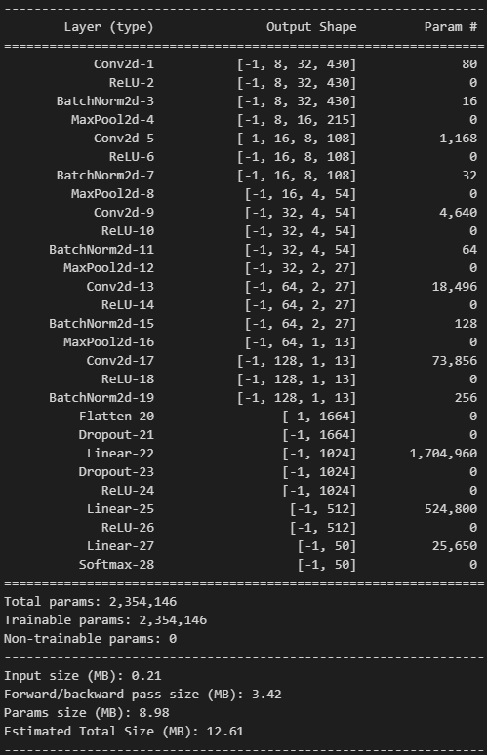
Conv2d-1
out channels: 8
kernel: 3
stride: 2
padding: 1
Conv2d-5
out channels: 16
kernel: 3
stride: 1
padding: 1
Conv2d-9
out channels: 32
kernel: 1
stride: 2
padding: 1
Conv2d-13
out channels: 64
kernel: 1
stride: 2
padding: 1
Conv2d-17
out channels: 128
kernel: 1
stride: 2
padding: 1
Best Models

Slide 12
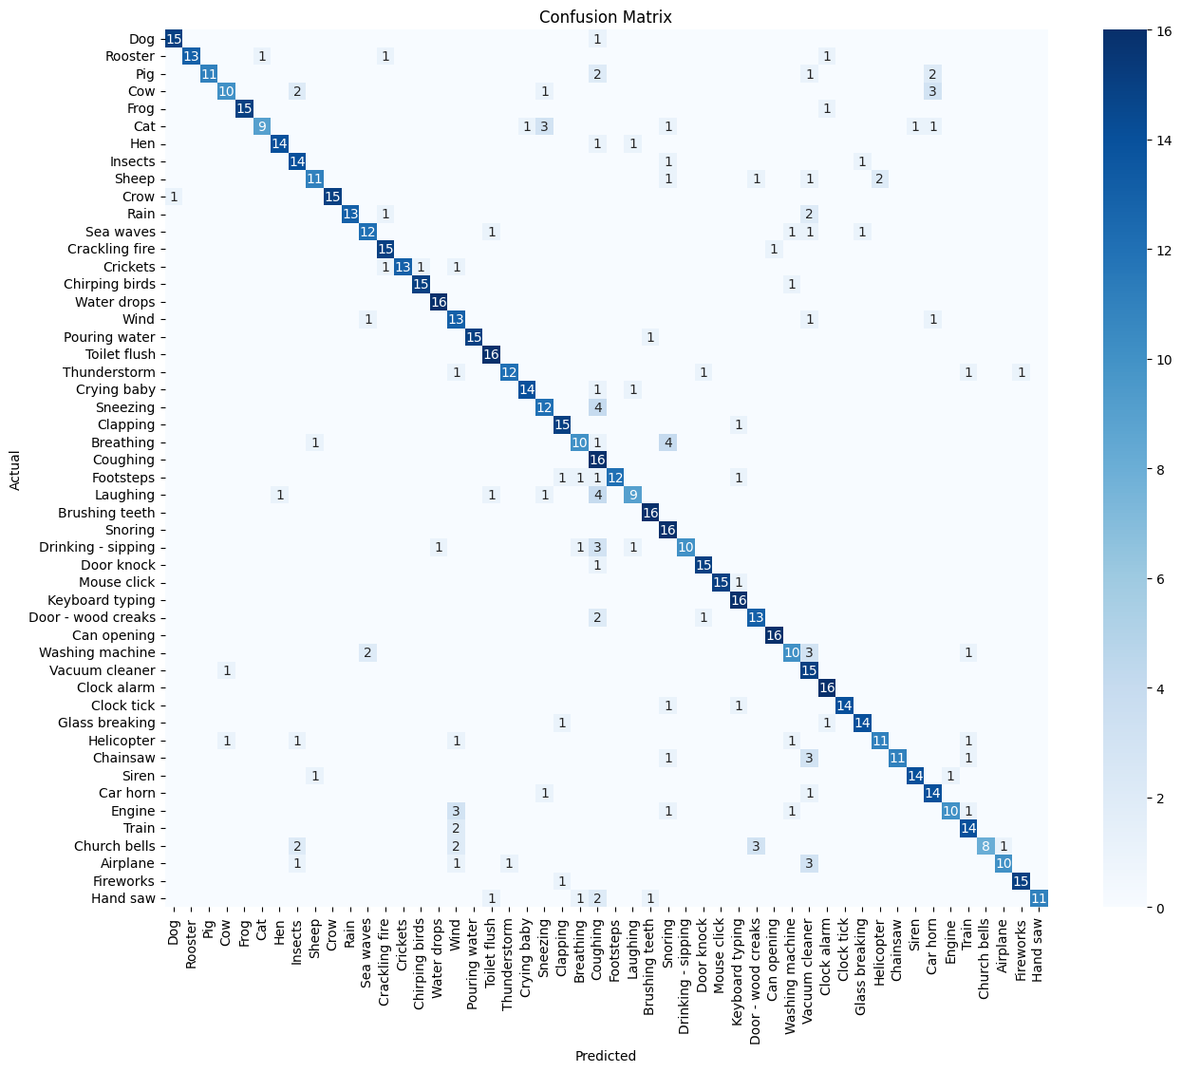
Resnet 18
Input Size: Melgram 64x860 (not normalized)
Trials: 9
Val Accuracy: 88.9%
Test Accuracy: 82.38%
All Layers Frozen
Best Models

Slide 13
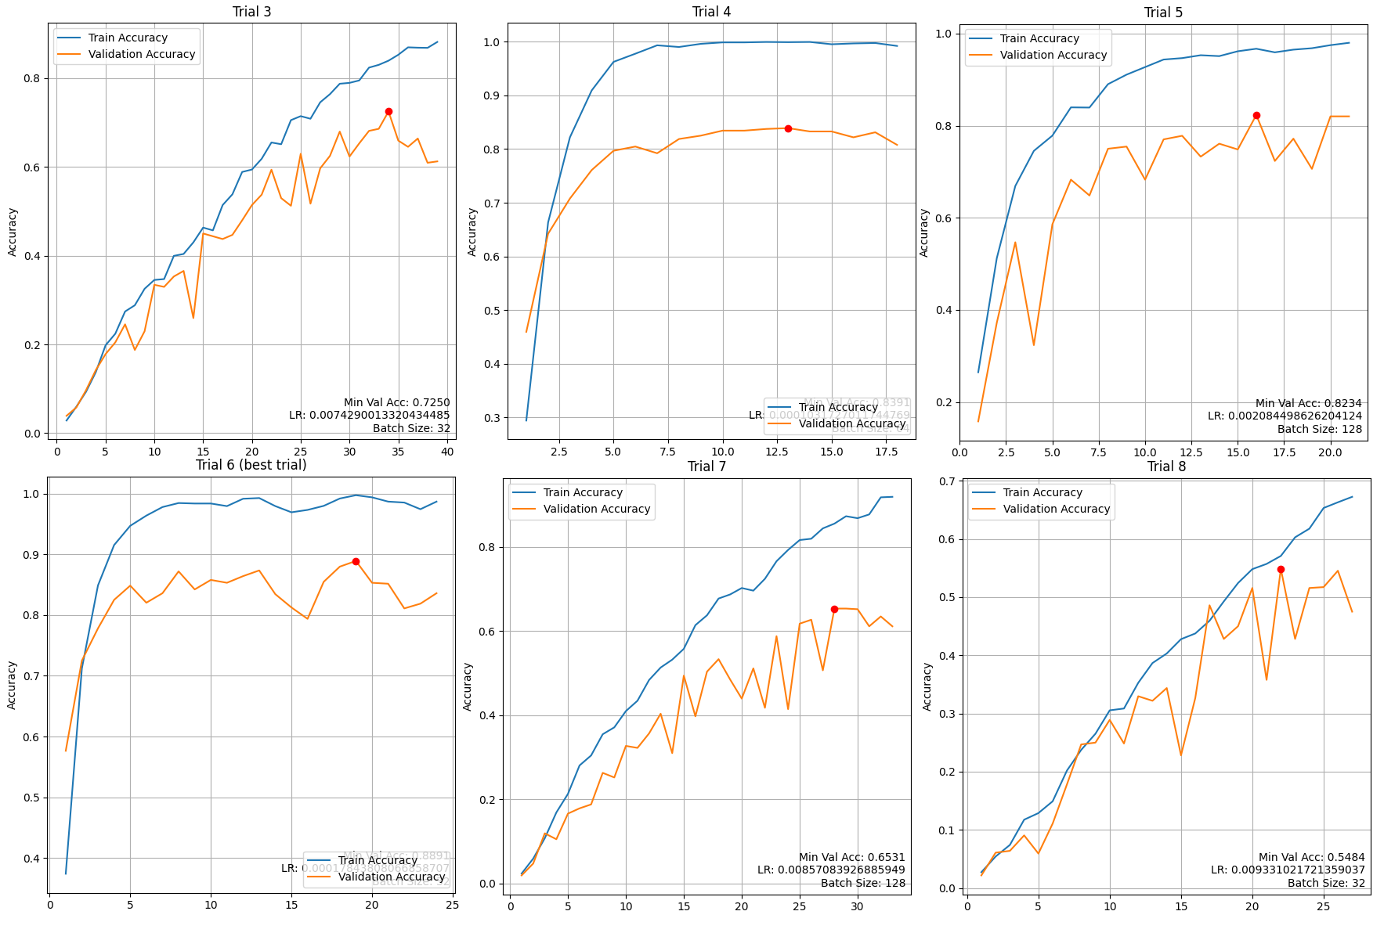
Best Models

Slide 14
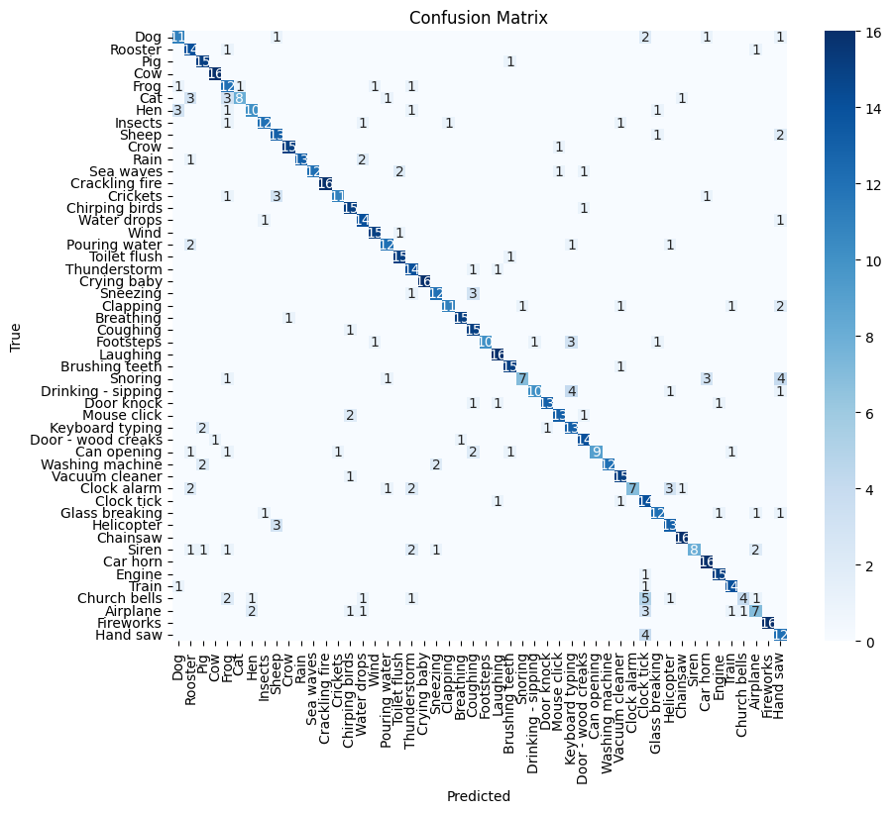
Resnet 18 + CNN
Input Size: Melgram 64x860 (normalized)
Trials: 9
Val Accuracy: 95,78%
Test Accuracy: 79.12%
FC Removed
Best Models

Slide 15
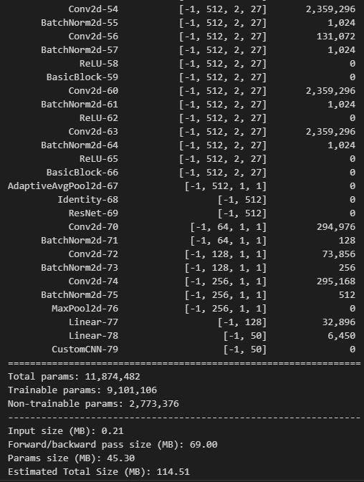
Conv2d-70
out channels: 64
kernel: 3
stride: 1
padding: 1
Conv2d-72
out channels: 128
kernel: 3
stride: 1
padding: 1
Conv2d-74
out channels: 256
kernel: 3
stride: 1
padding: 1
Best Models

